Slide 1
MSDAP Final Presentation
Lamin Jammeh (DAL852207)
Caleb Perez (CXP180012)

Slide 2
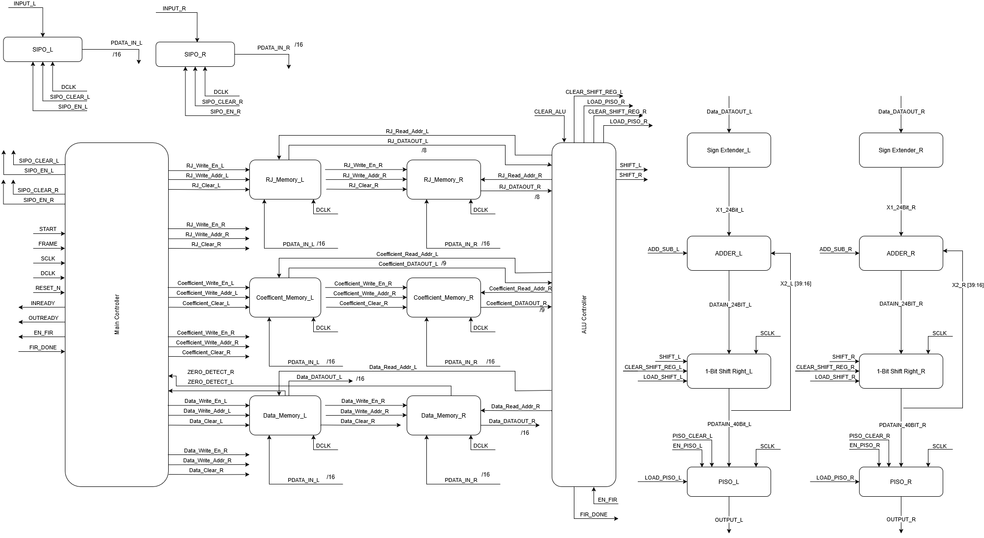
MSDAP Architecture
Datapath
Memories
Controller

Slide 3
MSDAP Architecture
Built as a hearing aid that processes input audio and outputs filtered audio to the user using a digital FIR convolution.
High priority is low power consumption, as it is not meant to be plugged in and will run on a small battery.
Two-process circuit
Keeps data path and control paths separate and distinct. (Previous slide)
Both Main Controller and ALU Controller are FSMs.
Allows for easy and distinct input-based control of the outputs.
Layout must be as small as possible as it should fit within the ear.

Slide 4
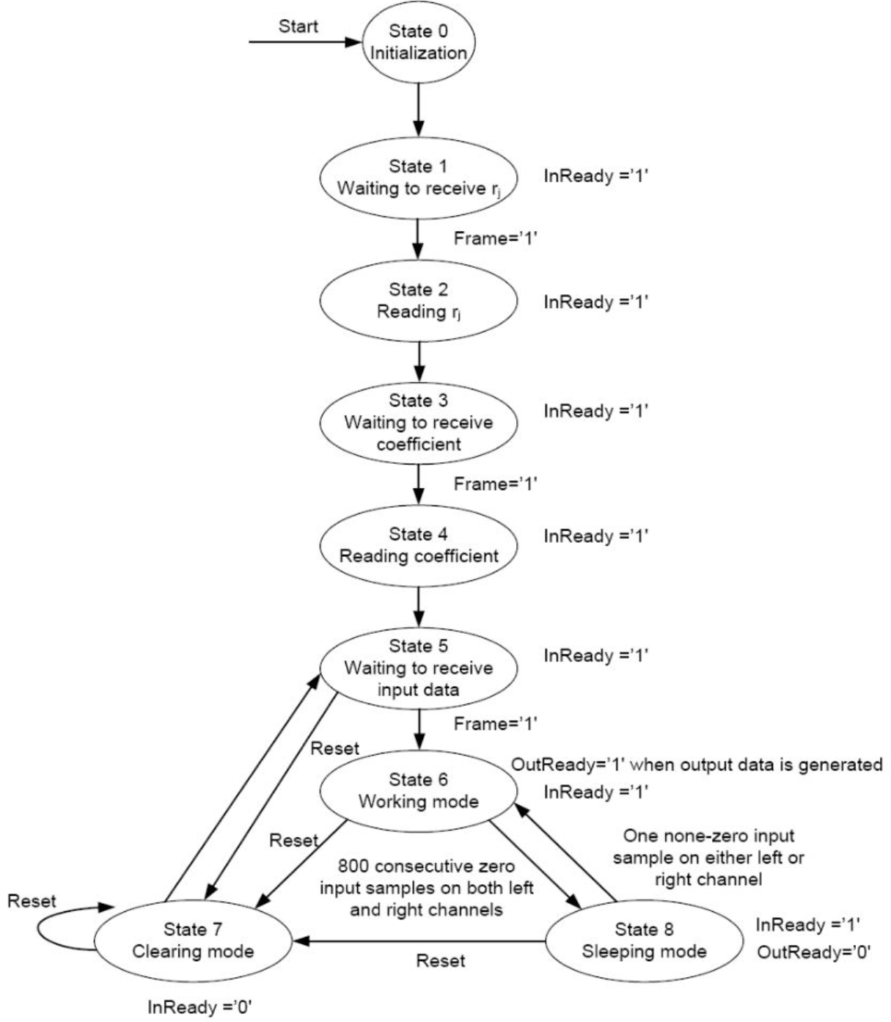
Original Code
Our original code was validated as far as State 6.
This means that we were able to store and recall data from the memories accordingly.
Could not get a proper output through the ALU data path.
Due to lack of proficiency in coding Verilog. Could not properly execute ALU sub-block actions in order.

Slide 5
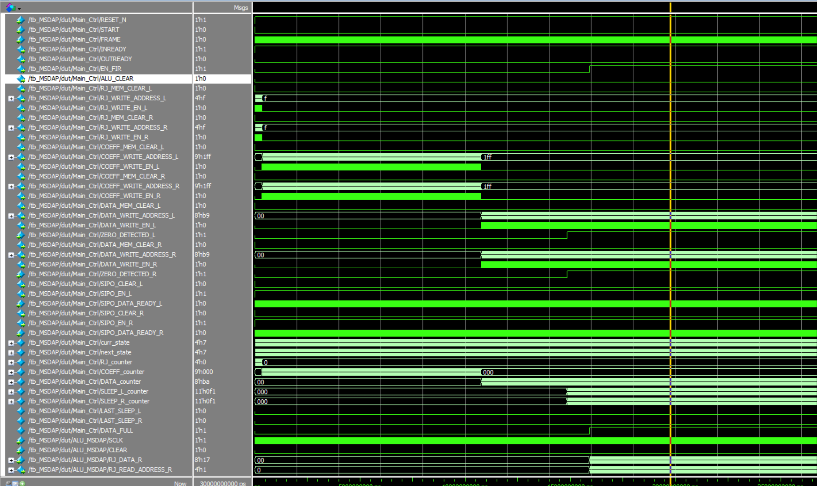
Original Code Simulations
Here we can see that our original code was successful in processing the initial RJ, Coeff, and Input Data, as well as providing said data while the ALU is attempting to process data.
We did make a testbench for the MSDAP, as well as testbenches for every block. This waveform is from the MSDAP testbench.
RJ Processing
Coeff Processing
Data Processing
RJ Readback into ALU

Slide 6
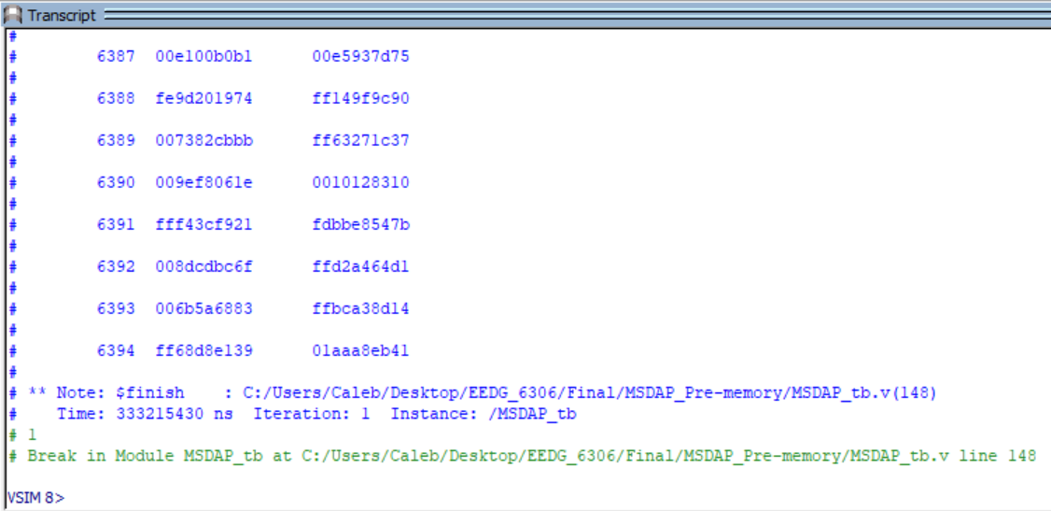
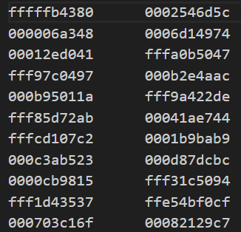
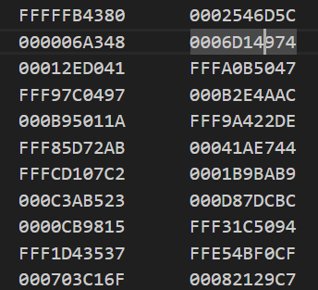
Utilization of Provided Code
Decision was made to utilize code provided by the TA.
Would allow us to continue with layout and finish the project.
Verified provided code output by comparing given data1.out to generated data1.out (Snippet shown on the right)
Generated:
Expected:

Slide 7
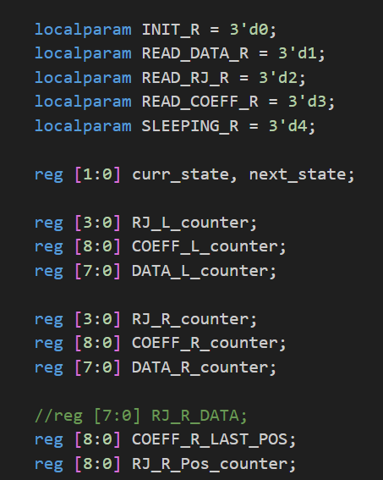
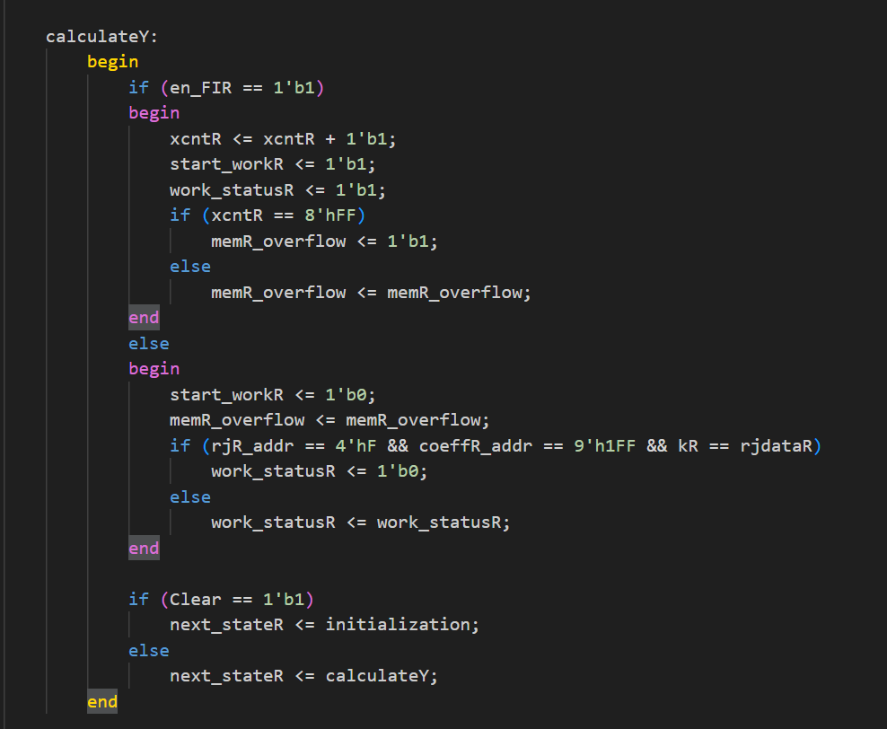
Differences in Provided Code and Original
Our ALU Controller Code
Provided ALU Controller Code
Too many states! Overcomplicated

Slide 8
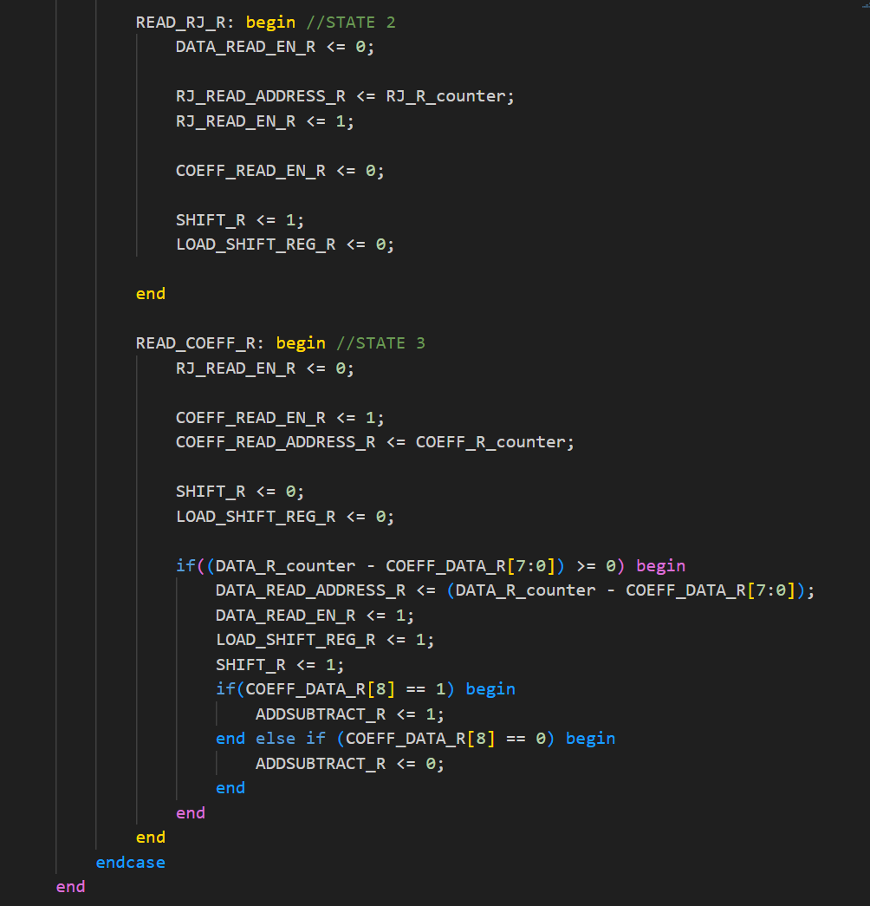
Differences in Provided Code and Original
Many more differences in how data was handled, but the ALU was where our original code failed. Overall, the provided code runs faster and is less bloated.
Our ALU Controller Code
Provided ALU Controller Code
Incorrect activation of ALU data path.

Slide 9
Constraints for synthesis
Clock constraints
Clock uncertainty for both Dclk and Sclk is +/-100ps
Dclk and Sclk period = 1302000.0ps and 3333.3ps respectively
Pin constraint
All loads set to 1pf
Floorplan constraint: this is important to make sure need instance don’t flattened or synthesize to induvial cells
All memories a plan as instance
The tool command instructions needs preserve all SRAMs

Slide 10
Tool commands used for Synthesis
set_db [get_designs SRAM1RW128x12] .dont_touch true
set_db [get_designs SRAM1RW128x12] .is_blackbox true
set_db [get_designs SRAM1RW256x8] .dont_touch true
set_db [get_designs SRAM1RW256x8] .is_blackbox true
set_db [get_designs SRAM2RW16x8] .dont_touch true
set_db [get_designs SRAM2RW16x8] .is_blackbox true
# 6. Elaborate top design
set_db [get_designs MSDAP] .auto_ungroup none
set_db [get_designs R_MEM] .auto_ungroup none
set_db [get_designs DATA_MEM] .auto_ungroup none
set_db [get_designs CO_MEM] .auto_ungroup none
The intension for the Floorplan is to place all memories as induvial components (use as given)
don’t_touch and is_blackbox prevents the SRAMs from getting flattened or synthesize into individual gates
To preserve hierarchy the auto_ungroup has been disabled for the R, Data, and Co modules

Slide 11
Preserve mem instances
# Auto-preserve only memory SRAM instances (not inner registers)
foreach cell [concat \
[get_cells -hierarchical *mem_0_0] \
[get_cells -hierarchical *mem_0_1] \
[get_cells -hierarchical *mem_0_2] \
[get_cells -hierarchical *mem_0_3] \
] {
if {[llength [get_cells -quiet $cell]] > 0} {
set_db $cell .preserve size_ok
puts "Preserved: $cell"
}
}
The following are preserve as instances for easy placement.
Mem_0_0
Mem_0_2
Mem_0_2
Mem_0_3

Slide 12
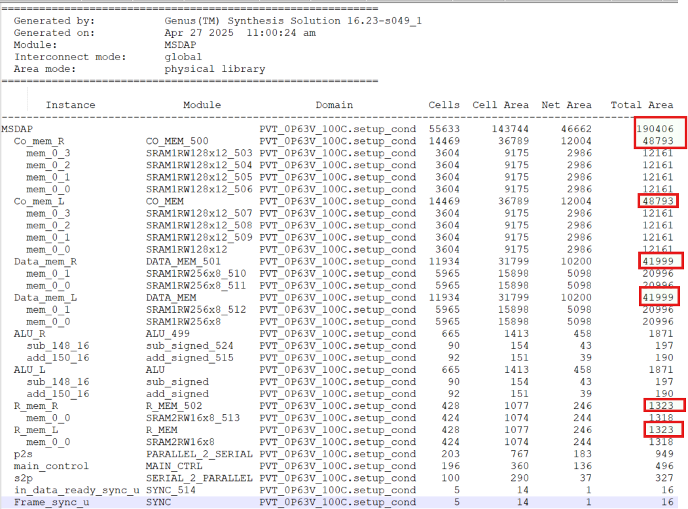
Syn area report

Slide 13
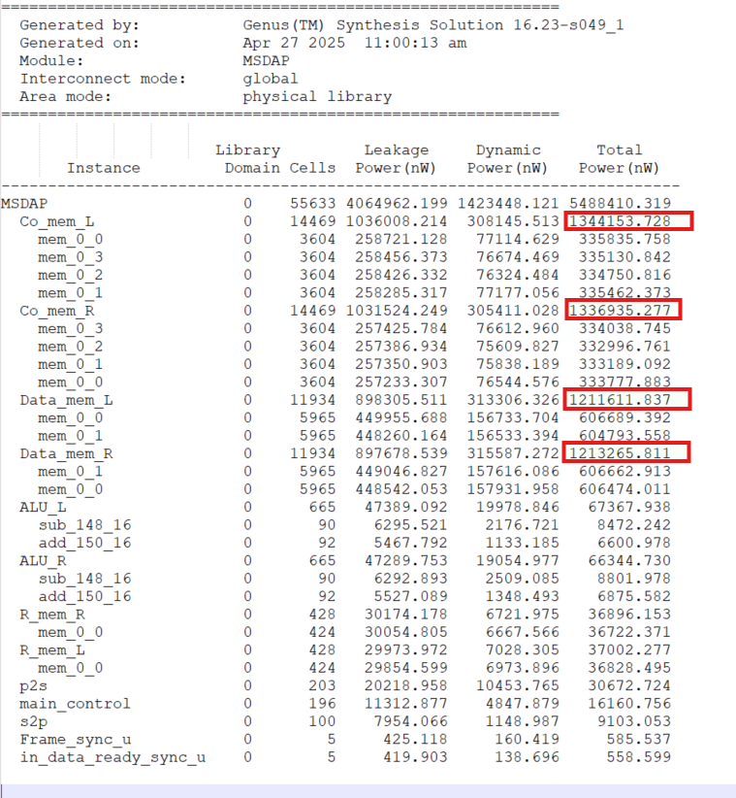
Syn Power report

Slide 14
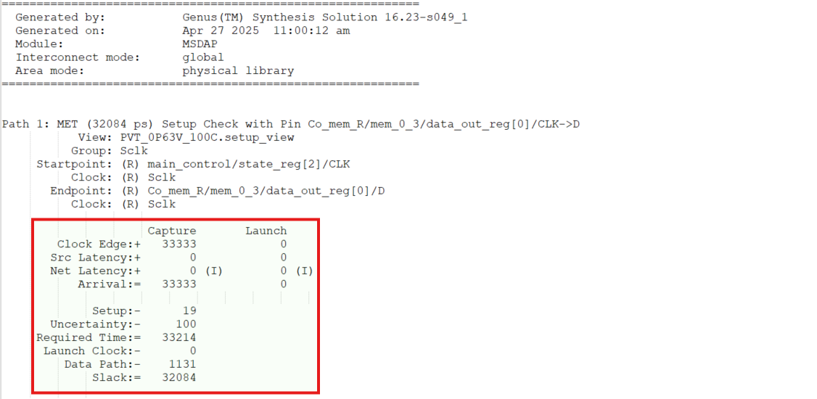
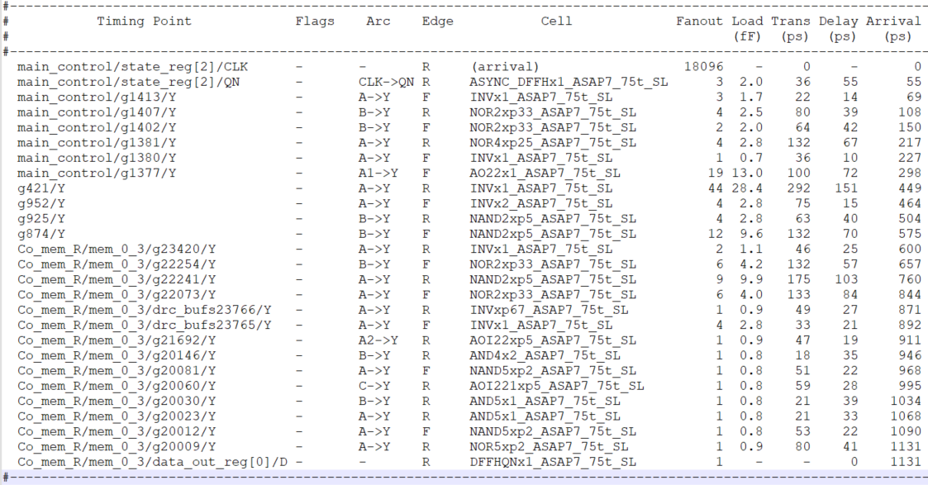
Syn Timing/ setup report

Slide 15
Syn PPA
PPA | Value
Power | 5.488410319 mW
Performance | 33333 ps = 30 MHz
Area | 564864 µm²

Slide 16
Place and Route Process Flow
Setup Environment
Set Process node for the circuit
Set timing constraints
Define the timing scale
Include lib exchange file for all cells in the netlist
Define all corners to set chip behavior under different conditions
Read Design netlist and define the top module in the netlist
Define your Power parameters (VDD and VSS)
Exclude cells that may cause issues

Slide 17
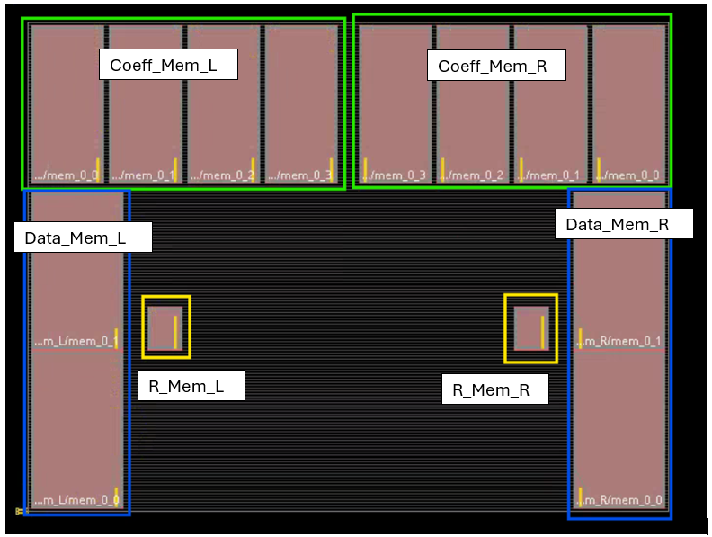
PnR Process Flow continues
Source floorplan
Make overall chip area is largeenough to fit all instance

Slide 18
Add physical constraints
Define physical contraint before placing Power rails
Define pith and offset rules
Add Via Rules
Define if via on IO pads are allowed
Add blockages or keepers to all corners of the chip

Slide 19
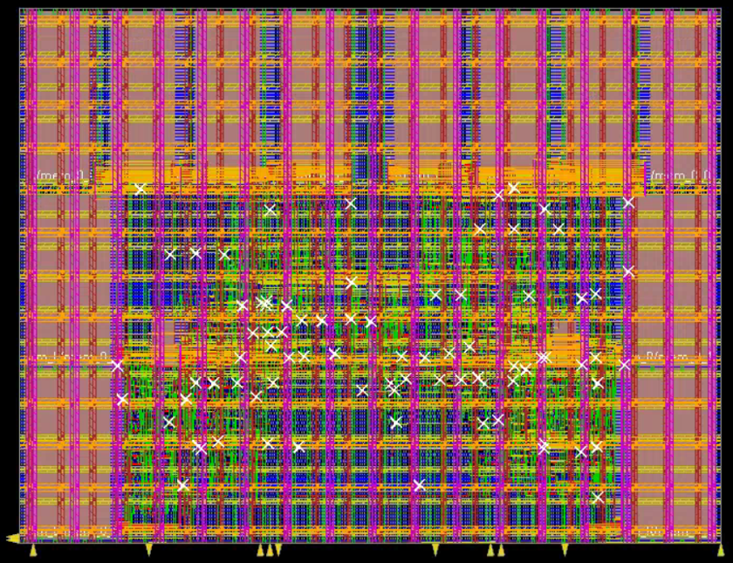
Placement
Add tap cells
Add Power Strapes
Place I/O pins
Place cells
Define clock tree
Define Keepouts for easy routing before adding filler cells

Slide 20
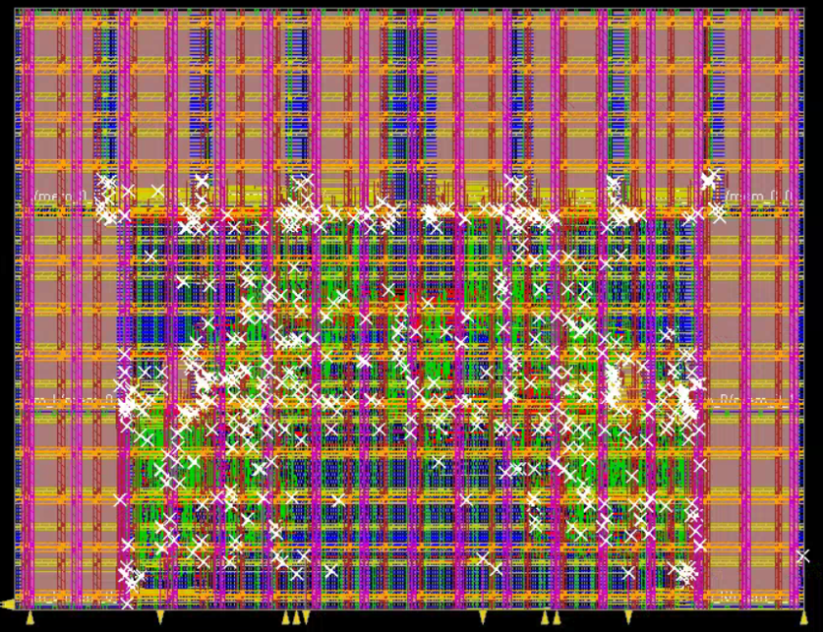
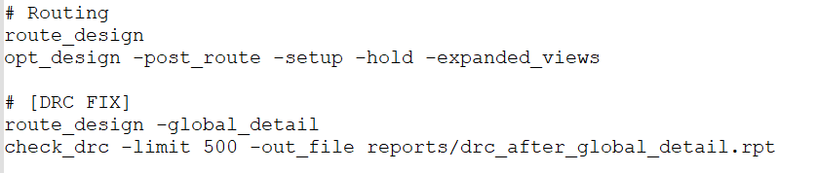
Route Design
Route using global_detail to help reduce DRC violations

Slide 21
Create the needed file for the next Process
Generate a def file for orphyiscal implementation
Generate a netlist for lvs that contains only the transistor level description of the desing without any physical description

Slide 22
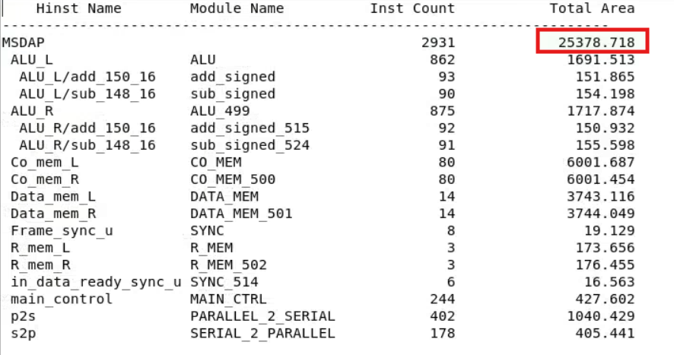
Design Report (Area)

Slide 23
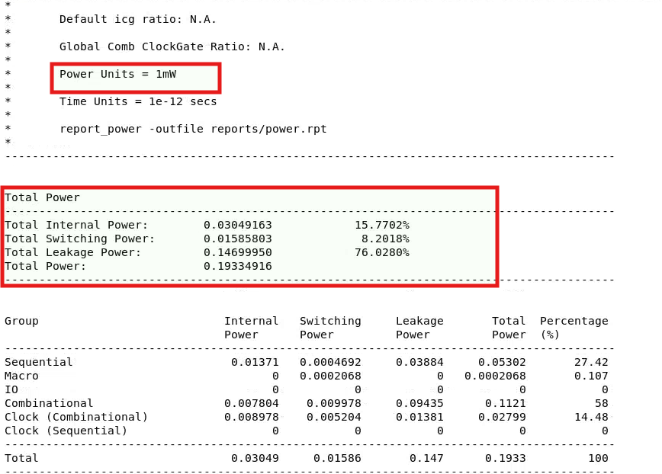
Design Report (Power)

Slide 24
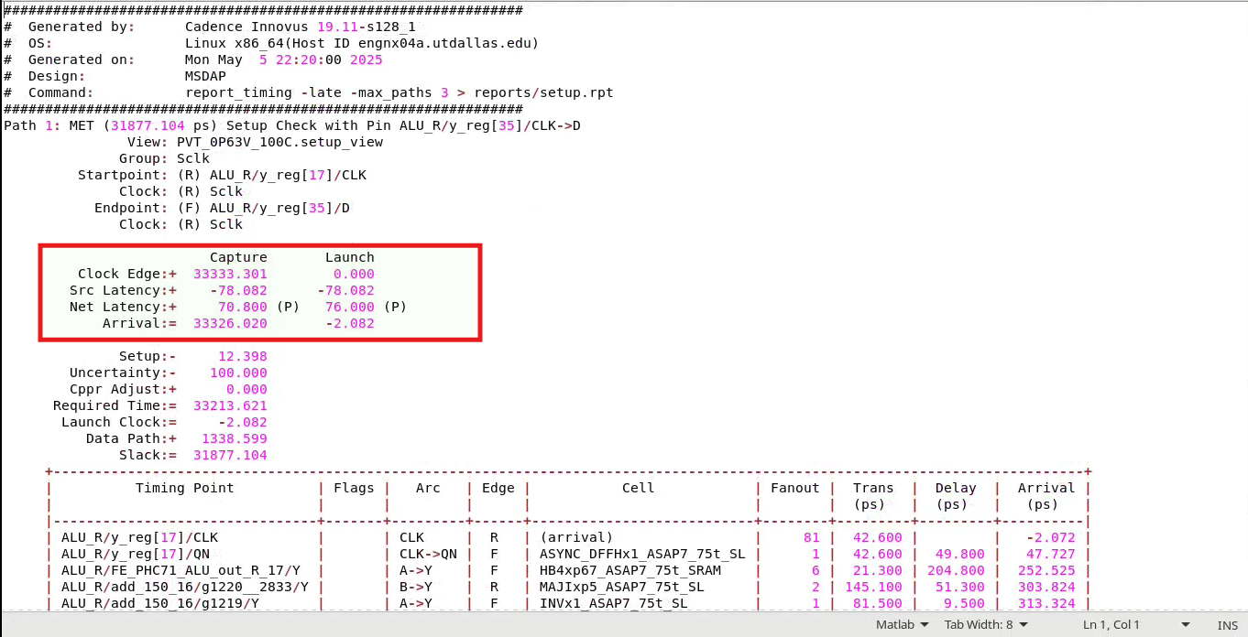
Design Report (Setup/timing)

Slide 25
PPA after PNR
PPA | Value
Power | 0.19334916 mW
Performance | 33326.020 ps = 30.011 MHz
Area (Design_area + cell_area) | 51150.28 µm²

Slide 26
PPA Syn vs PnR
PPA | Syn Values | PnR Values
Power | 5.488410319 mW | 0.19334916 mW
Performance | 33333 ps = 30 MHz | 33326.020 ps = 30.011 MHz
Area (Design_area + cell_area) | 564864 µm² | 51150.28 µm²

Slide 27
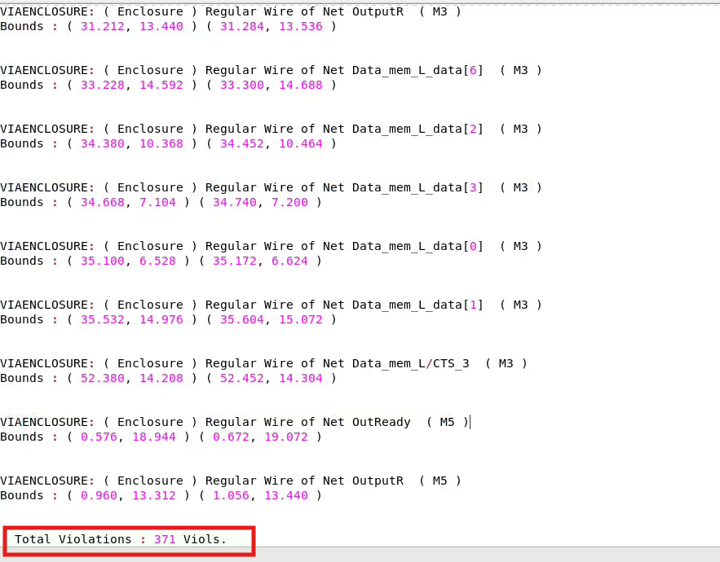
DRC report
Tota DRC errors = 371
Types of errors
ViaEnclosure violation
EndofLine violation
Error location
All errors happened around the SRAM macros
Reason: via rules define in the tool command did not apply to the macro sine the macros are define as instances (use as it is)

Slide 28
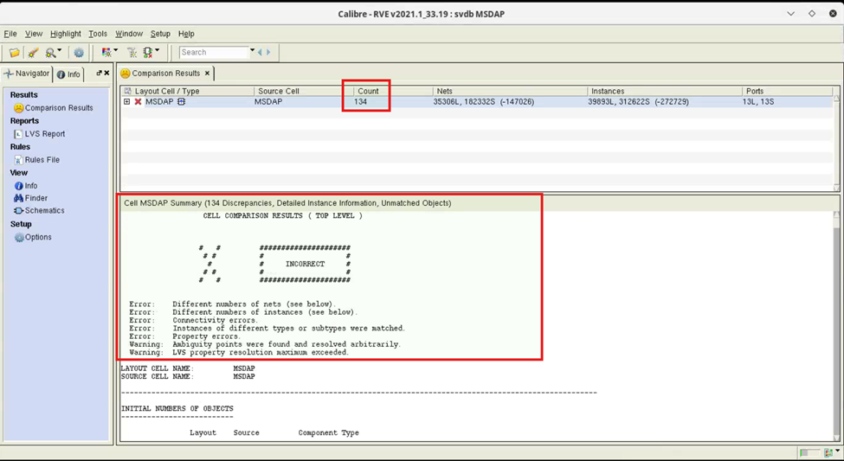
LVS errors

